Slide 1
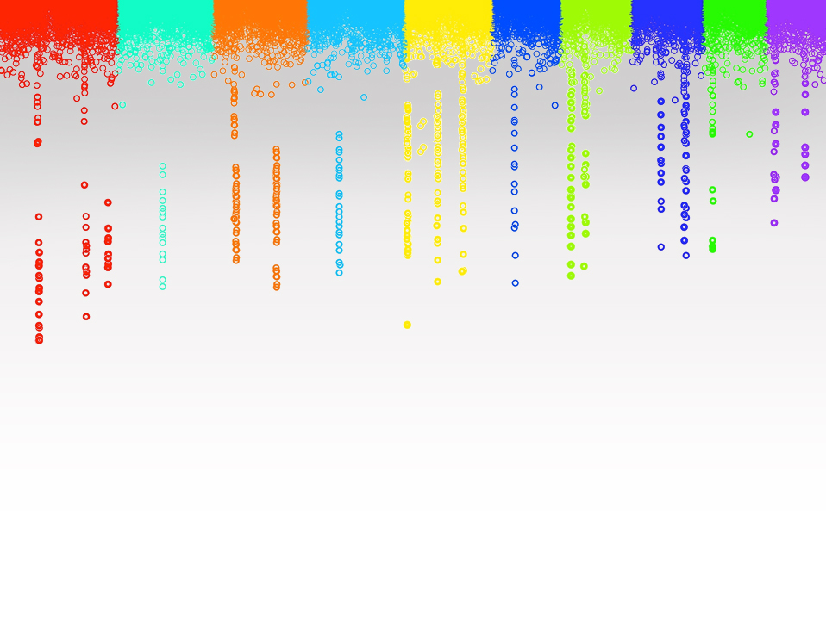

Statistical Genomics
Lecture 21: BLINK
Zhiwu Zhang
Washington State University

Slide 2
Outline
Bin problem
Computing demand of FarmCPU
BLINK method and software

Slide 3
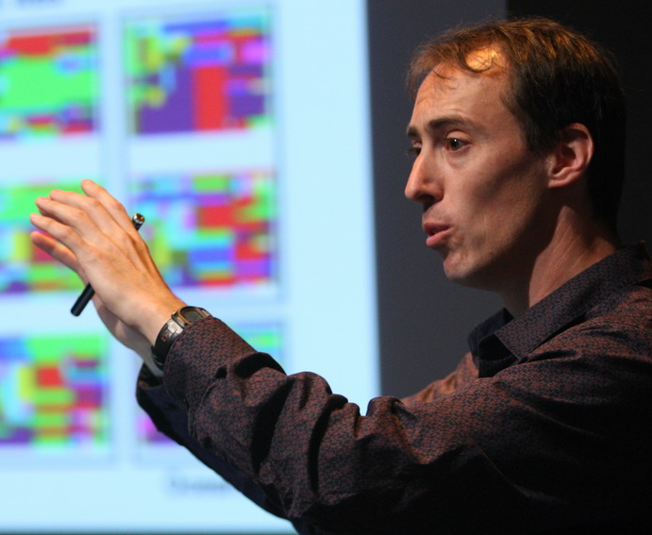



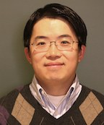




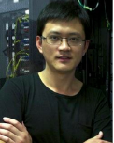
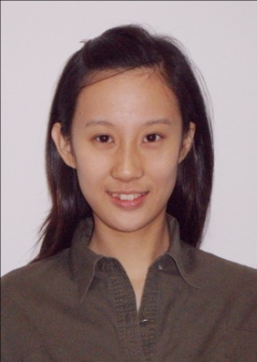

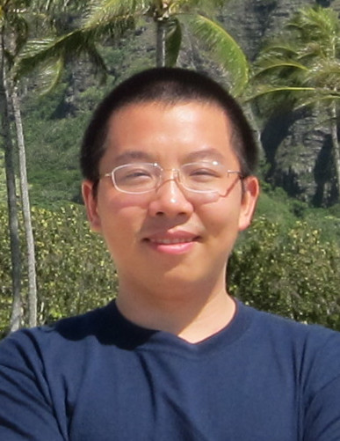



Q
EMMA
PC+K
PC
EMMAx
Q+K
GWAS Stream
MLMM
CMLM
P3D
SELECT
GCTA
ECMLM
FST-LMM
GEMMA
FarmCPU
GenAbel
BLINK

Slide 4
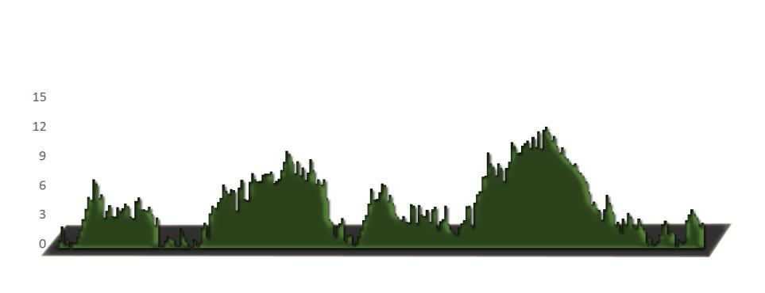
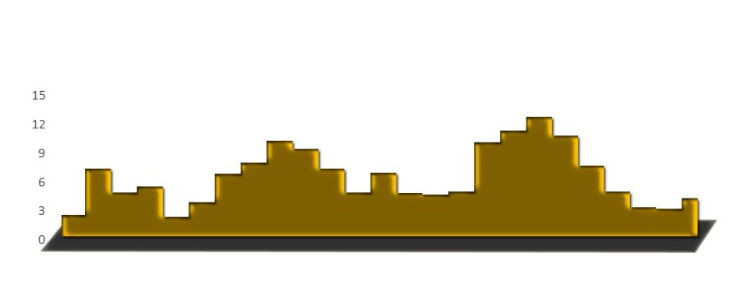
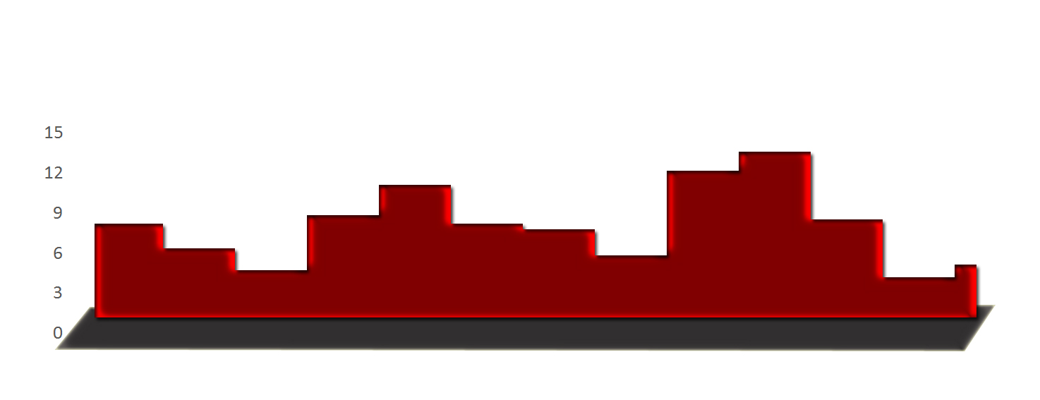
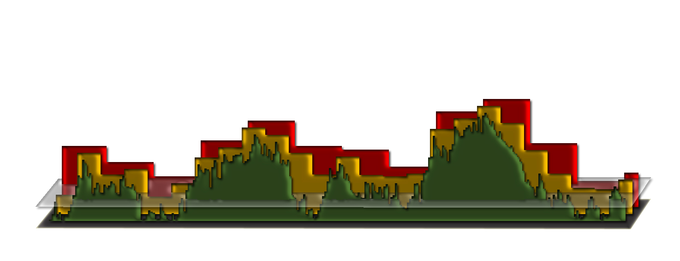
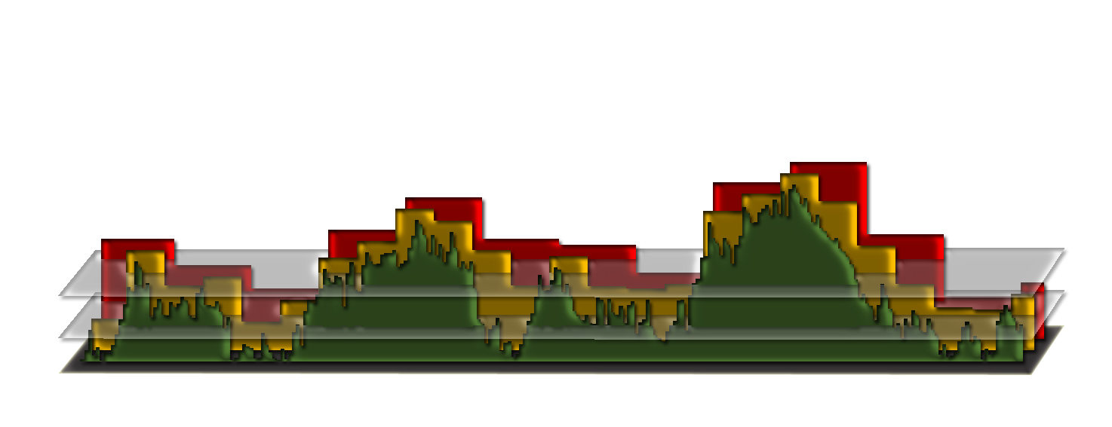
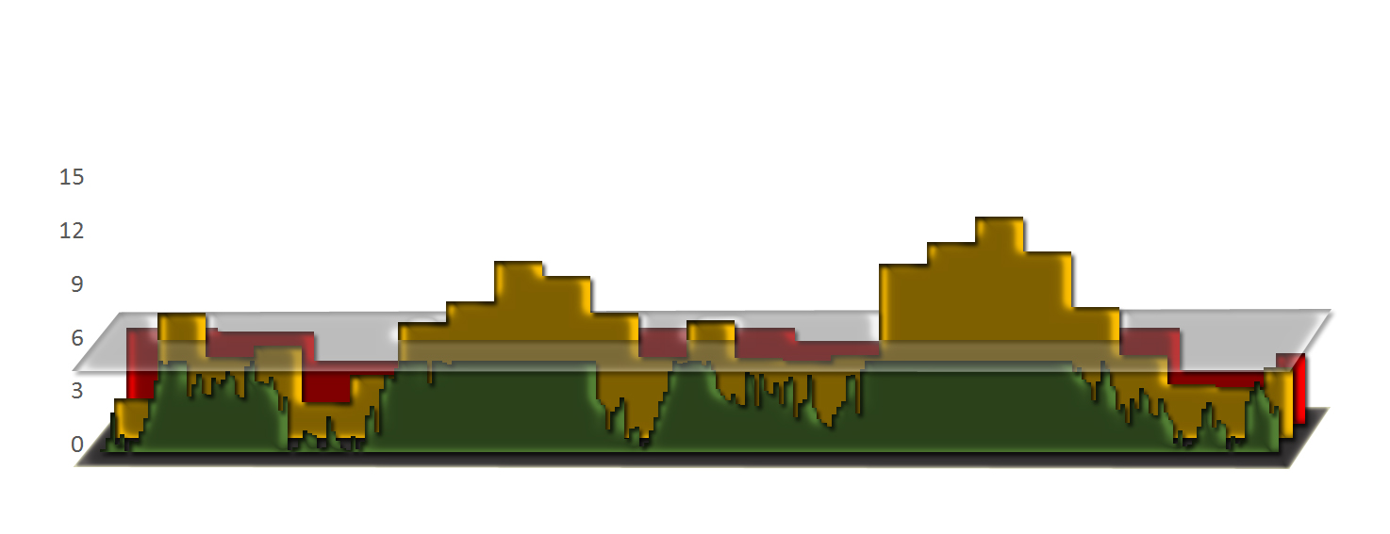
Bin approach

Slide 5
False
(bin too small)
Missing
(bin too big)
LD
clustered

Slide 6
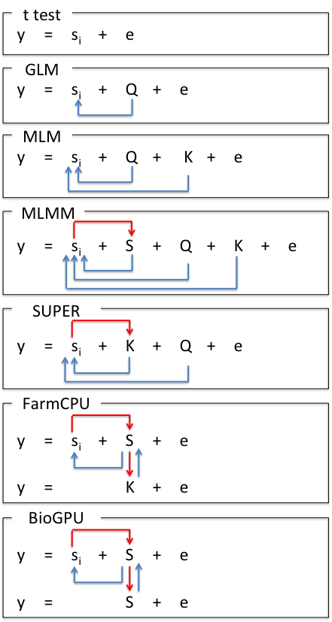
Model Development
S_{i}: Testing marker
Adjustment on marker
Q: Population structure
K: Kinship
Adjustment on covariates
S: Pseudo QTNs

Slide 7
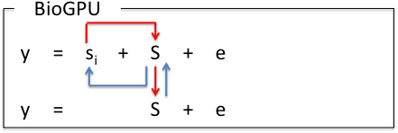
Model Development
S_{i}: Testing marker
Adjustment on marker
Q: Population structure
K: Kinship
Adjustment on covariates
S: Pseudo QTNs
BLINK

Slide 8
SUPER algorithm
y = PC + SNP + e
Bins
-2LL
QTNs
y = PC + Kinship + e
y = PC + Kinship + SNP + e

Slide 9
FarmCPU algorithm
y = PC + SNP + e
Bins
-2LL
QTNs
y = PC + Kinship + e
y = PC + QTNs + SNP + e

Slide 10
BLINK algorithm
y = PC + SNP + e
LD
BIC
QTNs
y = PC + QTNs + e
y = PC + QTNs + SNP + e

Slide 11
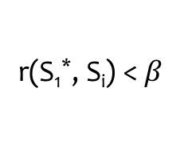
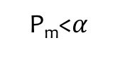
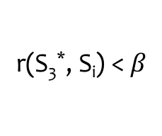
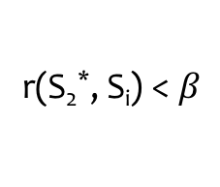
Remove SNPs in LD
S₁*
S₂
… |  | S₂*
… |  | … |  | S₃*
… |  | … |  | … |  | S_{t}*
… |  | …
S_{m}
…
S_{M}
r(S₁*, S_{i}) <$β$
r(S₂*, S_{i}) <$β$
r(S₃*, S_{i}) <$β$
P_{m}<$α$

Slide 12
Bayesian information criterion
BIC=-2LL+k Ln(n)
k
t

Slide 13
Bayesian information criterion
BIC=-2LL+k Ln(n)
y = s_{i} + S₁* + S₂ * + S₃ * + … + S_{k} * + e, where i = 1 to M
1
k
t
y = S₁* + S₂ * + S₃ * + … + S_{k} * + e, where k maximizes BIC

Slide 14
BLINK

Slide 15
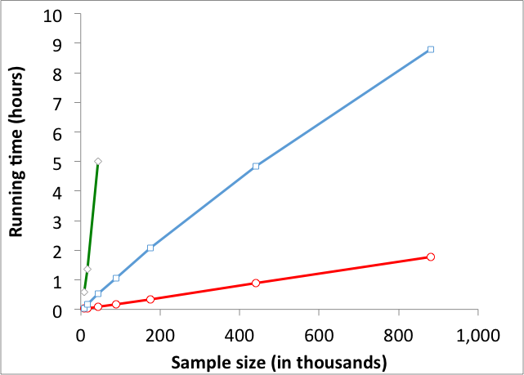
BLINK is super fast
Testing half million SNPs
PLINK
FarmCPU
BLINK
BLINK is 5X > PLINK, 200X > FarmCPU

Slide 16
http://zzlab.net/GAPIT/data/Workshop_Iowa.R
BLINK
FarmCPU
GAPIT
PLINK

Slide 17
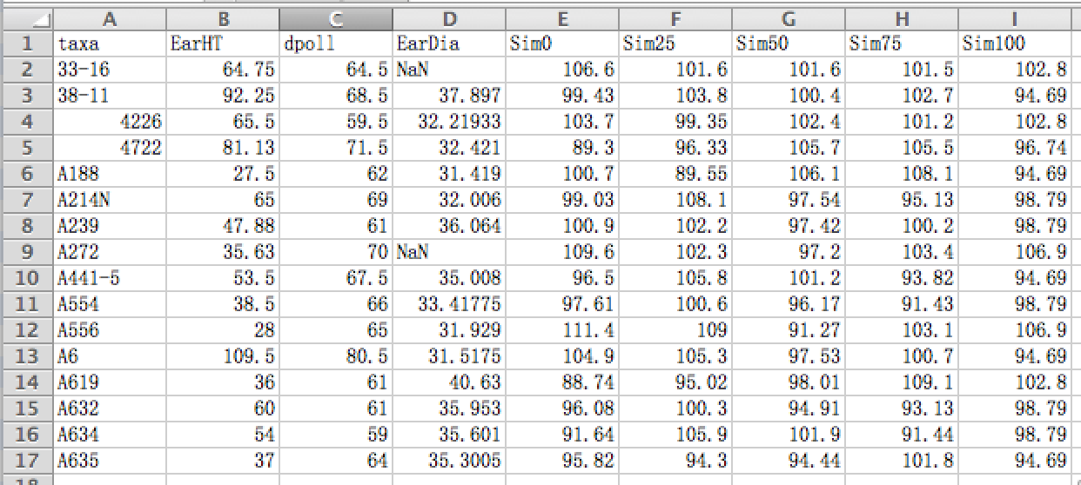
Format of phenotype data

Slide 18
Formats of genotype data
Numeric
VCF
BLINK
PLINK
HapMap

Slide 19
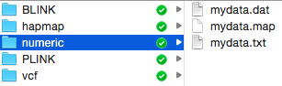
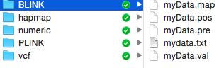
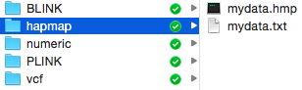
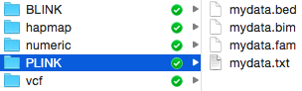
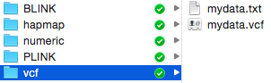
Format and file name extention

Slide 20
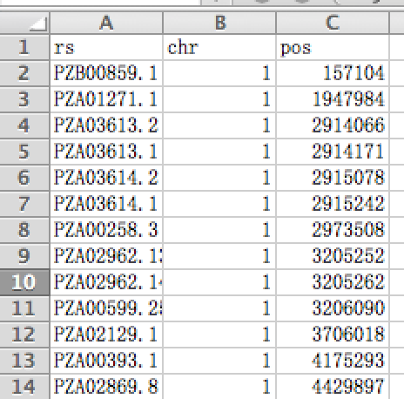
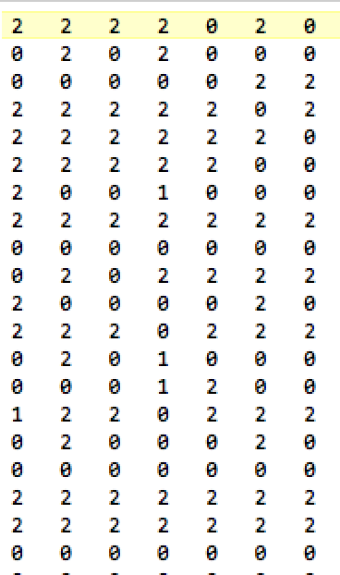
Numeric format
Individuals
SNPs
Genotype map
Genotype data

Slide 21
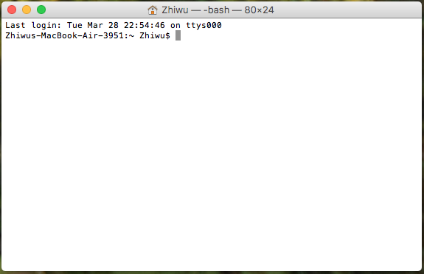
Run BLINK from command line
cd /Users/Zhiwu/Desktop/temp/demo_data/numeric
/Users/Zhiwu/Desktop/temp/blink --file myData --numeric --gwas --out myResult

Slide 22
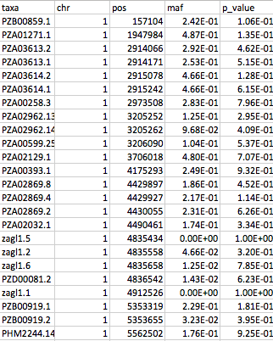
Output

Slide 23





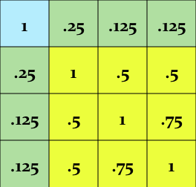
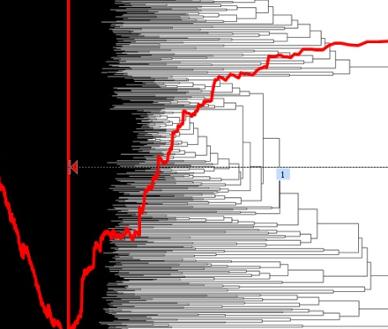
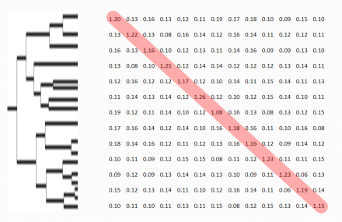
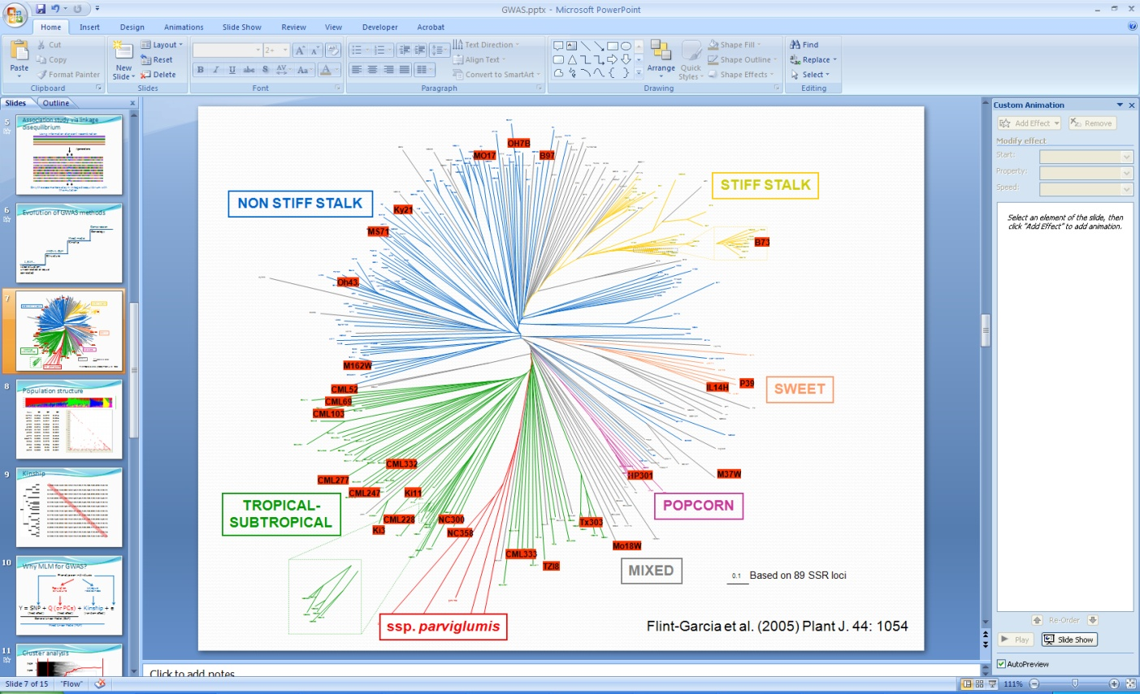
Ladder for high hanging fruits
GAPIT
TASSEL
GAPIT
ECMLM
EMMA, EMMAx,
GCAT, GenABEL
CMLM
Structure, Eigenstrate
PLIK
MLM
GLM
t, F, X²…
Uncorrelated or
equally correlated

Slide 24
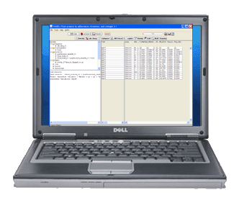
Demonstration

Slide 25
Import GAPIT
rm(list=ls())
#Import GAPIT
#source("http://www.bioconductor.org/biocLite.R")
#biocLite("multtest")
#install.packages("gplots")
#install.packages("scatterplot3d")#The downloaded link at: http://cran.r-project.org/package=scatterplot3d
rm(list=ls())
library('MASS') # required for ginv
library(multtest)
library(gplots)
library(compiler) #required for cmpfun
library("scatterplot3d")
source("http://www.zzlab.net/GAPIT/emma.txt")
source("http://www.zzlab.net/GAPIT/gapit_functions.txt")
#source("~/Dropbox/GAPIT/Functions/emma.txt")
#source("~/Dropbox/GAPIT/Functions/gapit_functions.txt")

Slide 26
Import data and simulation
#Import demo data
myGD=read.table(file="http://zzlab.net/GAPIT/data/mdp_numeric.txt",head=T)
myGM=read.table(file="http://zzlab.net/GAPIT/data/mdp_SNP_information.txt",head=T)
#myGD=read.table(file="~/Dropbox/Current/ZZLab/WSUCourse/CROPS545/Demo/mdp_numeric.txt",head=T)
#myGM=read.table(file="~/Dropbox/Current/ZZLab/WSUCourse/CROPS545/Demo/mdp_SNP_information.txt",head=T)
#Simultate 10 QTN on the first half chromosomes
X=myGD[,-1]
index1to5=myGM[,2]<6
X1to5 = X[,index1to5]
taxa=myGD[,1]
set.seed(99164)
GD.candidate=cbind(taxa,X1to5)
mySim=GAPIT.Phenotype.Simulation(GD=GD.candidate,GM=myGM[index1to5,],h2=.5,NQTN=10, effectunit =.95,QTNDist="normal")
hist(mySim$effect)

Slide 27
ttest
#GWAS by GAPIT
setwd("~/Desktop/temp")
myGAPIT=GAPIT(
Y=mySim$Y,
GD=myGD,
GM=myGM,
QTN.position=mySim$QTN.position,
PCA.total=0,
group.from = 1,
group.to = 1,
group.by = 10,
#sangwich.top="MLM", #options are GLM,MLM,CMLM, FaST and SUPER
#sangwich.bottom="SUPER", #options are GLM,MLM,CMLM, FaST and SUPER
memo="ttest")

Slide 28
GLM
#GWAS by GAPIT
setwd("~/Desktop/temp")
myGAPIT=GAPIT(
Y=mySim$Y,
GD=myGD,
GM=myGM,
QTN.position=mySim$QTN.position,
PCA.total=3,
group.from = 1,
group.to = 1,
group.by = 10,
#sangwich.top="MLM", #options are GLM,MLM,CMLM, FaST and SUPER
#sangwich.bottom="SUPER", #options are GLM,MLM,CMLM, FaST and SUPER
memo="GLM")

Slide 29
MLM
#GWAS by GAPIT
setwd("~/Desktop/temp")
myGAPIT=GAPIT(
Y=mySim$Y,
GD=myGD,
GM=myGM,
QTN.position=mySim$QTN.position,
PCA.total=3,
group.from = 1000,
group.to = 1000,
group.by = 10,
#sangwich.top="MLM", #options are GLM,MLM,CMLM, FaST and SUPER
#sangwich.bottom="SUPER", #options are GLM,MLM,CMLM, FaST and SUPER
memo="MLM")

Slide 30
CMLM
#GWAS by GAPIT
setwd("~/Desktop/temp")
myGAPIT=GAPIT(
Y=mySim$Y,
GD=myGD,
GM=myGM,
QTN.position=mySim$QTN.position,
PCA.total=3,
group.from = 1,
group.to = 1000,
group.by = 10,
#sangwich.top="MLM", #options are GLM,MLM,CMLM, FaST and SUPER
#sangwich.bottom="SUPER", #options are GLM,MLM,CMLM, FaST and SUPER
memo="CMLM")

Slide 31
SUPER
#GWAS by GAPIT
setwd("~/Desktop/temp")
myGAPIT=GAPIT(
Y=mySim$Y,
GD=myGD,
GM=myGM,
QTN.position=mySim$QTN.position,
PCA.total=3,
group.from = 1,
group.to = 1000,
group.by = 10,
sangwich.top="MLM", #options are GLM,MLM,CMLM, FaST and SUPER
sangwich.bottom="SUPER", #options are GLM,MLM,CMLM, FaST and SUPER
memo="SUPER")

Slide 32
FarmCPU
#Compare FarmCPU#Installation of required R package (once for a computer, details see FarmCPU user manual.)
# install.packages("bigmemory")
# install.packages("biganalytics")
#Import library (each time to start R)
library(bigmemory)
library(biganalytics)
require(compiler) #for cmpfun
source("http://www.zzlab.net/FarmCPU/FarmCPU_functions.txt")#web source code
myFarmCPU= FarmCPU(
Y=mySim$Y,
GD=myGD,
GM=myGM )
myP=as.numeric(myFarmCPU$GWAS$P.value)
myGI.MP=cbind(myGM[,-1],myP)
GAPIT.Manhattan(GI.MP=myGI.MP,seqQTN=mySim$QTN.position)
GAPIT.QQ(myP)

Slide 33
BLINK
myY=mySim$Y
colnames(myY)=c("taxa", "SimPheno")
setwd("~/Desktop/temp")
myGD1=t(myGD[,-1])
write.table(myY,file="myData.txt",quote=F,row.name=F,col.name=T,sep="\t")
write.table(myGD1,file="myData.dat",quote=F,row.name=F,col.name=F,sep="\t")
write.table(myGM,file="myData.map",quote=F,row.name=F,col.name=T,sep="\t")
#run blink
system("~/Desktop/temp/blink --file myData --max_loop 10 --numeric --gwas")
#Extract p values
result<- read.table("SimPheno_GWAS_result.txt", head = TRUE)
myP=as.numeric(result[,5])
myGI.MP=cbind(myGM[,-1],myP)
GAPIT.Manhattan(GI.MP=myGI.MP,seqQTN=mySim$QTN.position)
GAPIT.QQ(myP)

